Slide 1

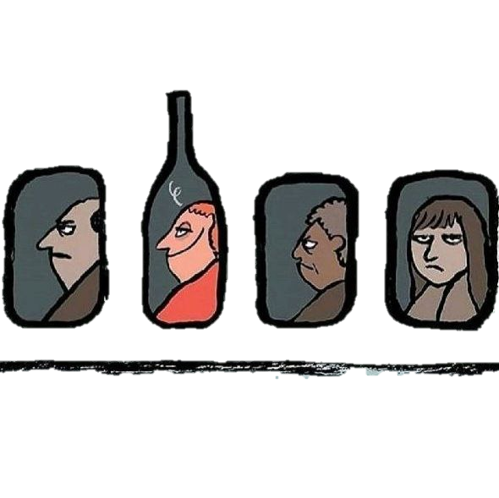

Team 5
Analysis on Quality of WINE
About us -
Bhagyasree (TL)
Naga Tejaswini
Yashas
Umamahesh
Pranav

Slide 2
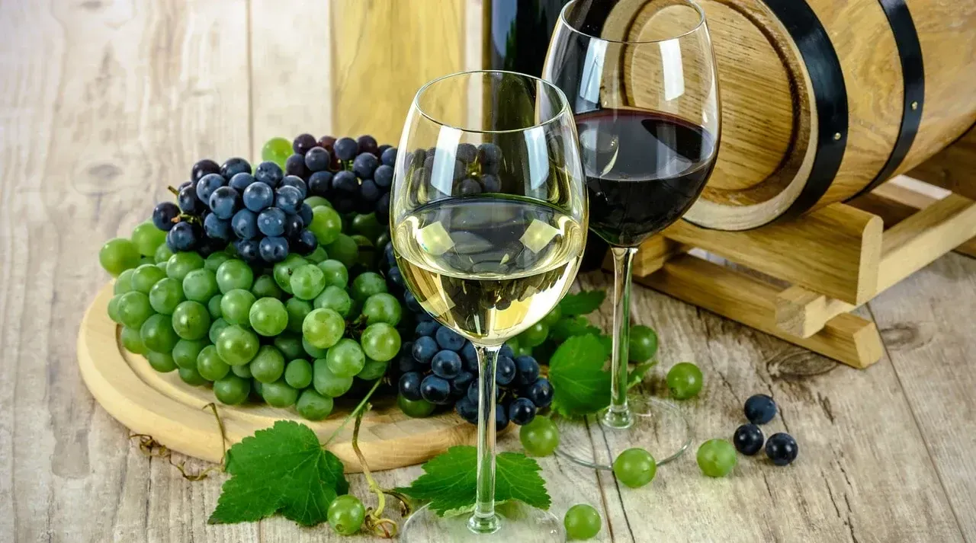

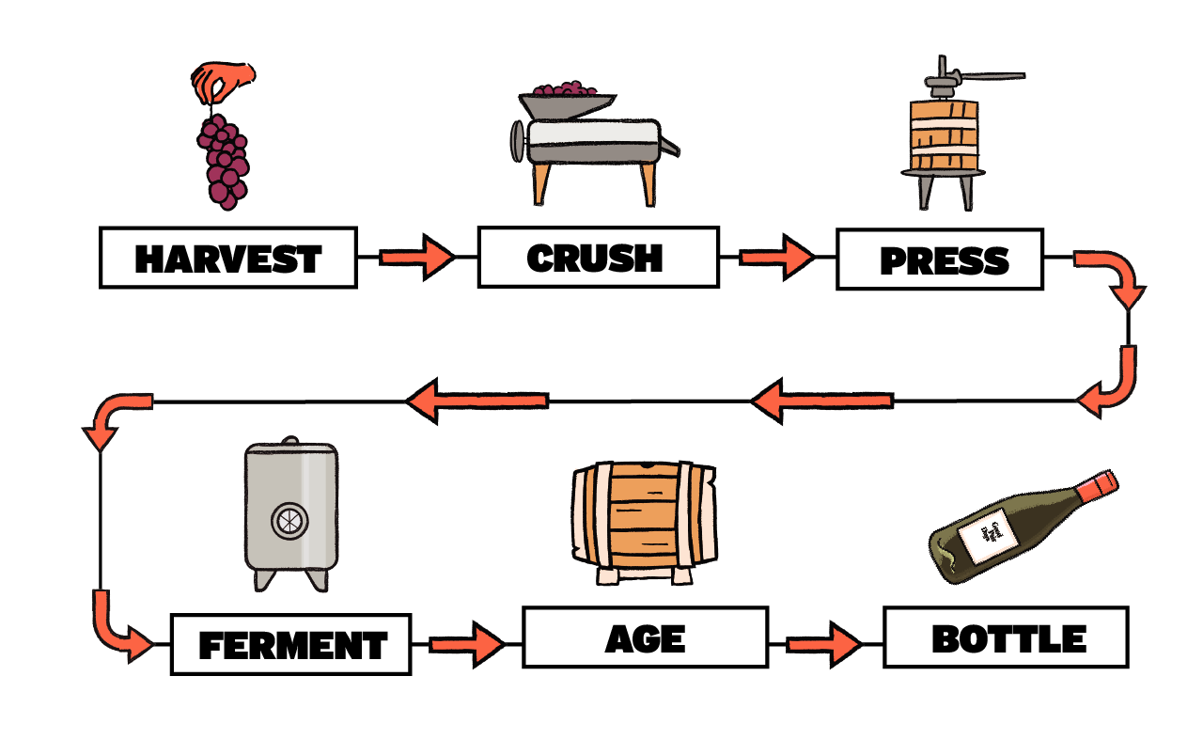
Wine Making Process :
(Maturation)

Slide 3
What Makes a Quality wine ?
Many conditions favor in quality wine :
Types of grapes used (color)
The condition of environment (ex : Temp , Weather …)
Level of sweet fruitness (of grapes) match up to acidity
Amount of Alcohol (the heat you feel at the back of your throat after sipping)
oak (It adds flavour compounds, such as aromas of vanilla, clove, smoke and coconut by using oak wood barrels.)
Tannins (Tannin acid - which dries out your mouth making you thirsty for more).
Fermentation …

Slide 4
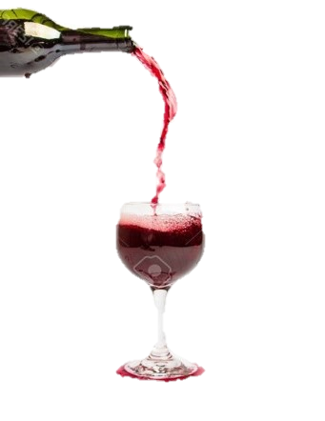
Agenda:
Problem Statement
Libraries Used
EDA Life Cycle
Data Description
Exploratory Data Analysis
Conclusion
Data Driven Insights .

Slide 5




Understanding Characteristics of wine : 1 . What should be the range of various chemicals for getting the best quality of wine ? 2 . Visualise to depict how these combinations of various ingredients is affecting the quality of wine ?
Problem Statement:
Libraries Used:
Numpy
Pandas
Matplotlib (Pyplot)
Seaborn

Slide 6


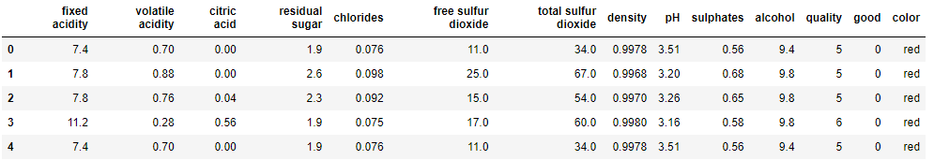
Exploratory Data Analysis
Life Cycle:
Business Understanding
Data Collection
(LOADING)
Data Cleaning
Data Analysis
Data Visualization
Insights
Data Description:
6497 DataPoints,14 Features
Dataset contains information about wine .
Wine Quality is measured on 0 to 10 scale .
OBERVATION – 1177 Duplicates datapoints.

Slide 7
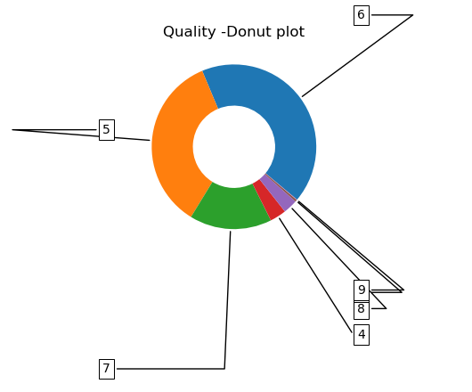
Quality Analysis –
Discrete Numerical Column
Scale | 6 | 5 | 7 | 4 | 8 | 3 | 9
Percentage (Normalised) | 43.6 | 32.9 | 16.6 | 3.32 | 2.97 | 0.46 | 0.07
Normal Q (5 to 7) | 76.5%
Excellent Q (>=7) | 19.94%
Poor Q (<=5) | 36.68%
Observation:
Normal Quality of wine
occupy 77% of data

Slide 8
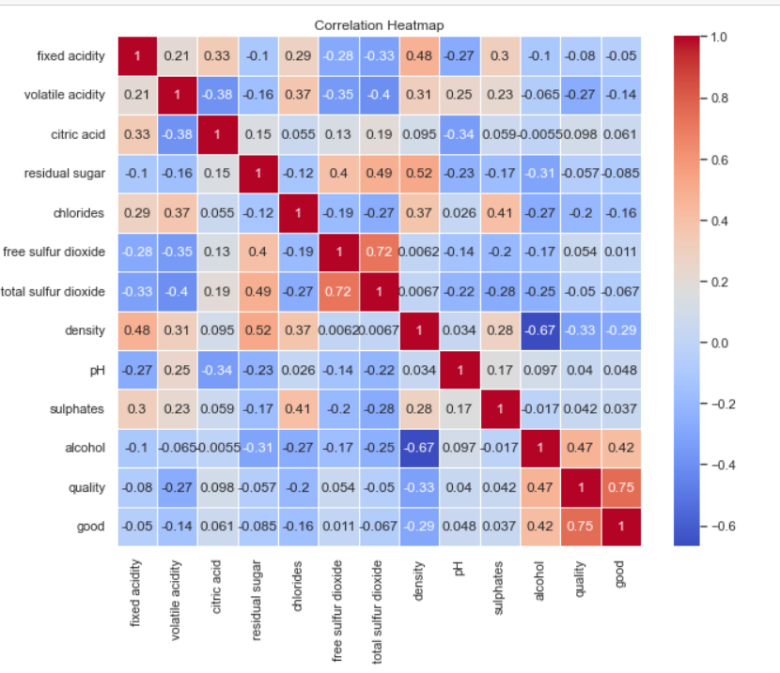
Correlation Matrix: Heatmap
Pearson correlation coeffiecient | Range | Proportionality
Strong | >= 0.5 | + → Directly
Weak | <=0.5 | - → Inversely
Observation:
Quality V/S Alcohol → Moderate

Slide 9
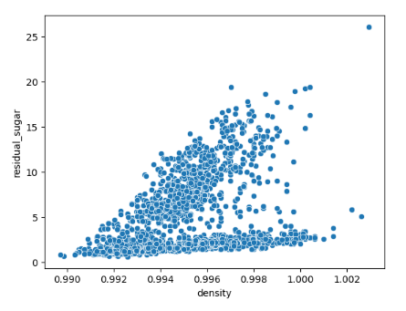
The correlation in
residual _sugar and density:

Slide 10
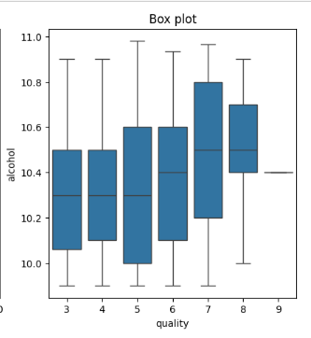
Alcohol V/S Quality:
Observation:
For the high quality wine , alcohol content should be 10.4 – 10.7.

Slide 11
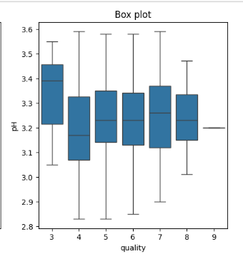
Does pH affect the quality of wine?
Observation:
The range of pH value is almost similar to the wine with quality of 4,5,6,7.
The wine with quality 8 lies pH lie in the range of 3.15 – 3.3.

Slide 12
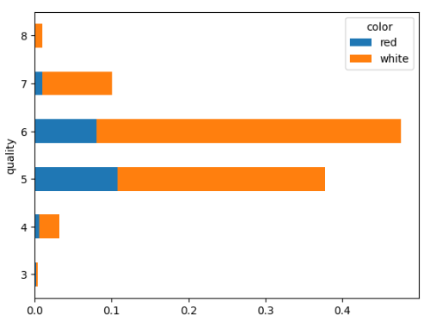
Is Certain type of wine (red/white)
associated with higher quality ?
Observation:
White wine is having
more quality as comparing to Red Wine.

Slide 13
Conclusion:
Composition | Range
Fixed acidity | 6.76 – 7.22 gram/litre.
Volatile acidity | 0.24 – 0.31 gram/litre.
Residual sugar | 2.0 – 4.3 gram/litre.
pH | 3.15 – 3.33.
Chlorides | 0.030 -- 0.038 gram/litre.
Sulphates | 0.41 -- 0.57 gram/litre.
Density | 0.9905 -- 0.9915 gram/milliliter.
Alcohol | 10.4 – 10.7 percentage/volume.
Free sulfur dioxide | 28 -- 33.5 milligram/litre.

Slide 14
Data Driven Insights:
Normal quality of wine occupies more data (range - 5 to 7)
According to data , the higher quality of wine has more acidic[pH=3.15 – 3.3]
White wine has more quality than red wine
Quality of wine depends on alcohol, pH.

Slide 15
https://www.quora.com/Why-do-some-wines-taste-bitter-or-sour-while-others-taste-sweet-and-nice#:~:text=Wines%20can%20taste%20bitter%20or,in%20the%20wine%20after%20fermentation. https://www.geeksforgeeks.org/donut-chart-using-matplotlib-in-python/ https://matplotlib.org/stable/gallery/pie_and_polar_charts/pie_and_donut_labels.html
References:

Slide 16


Slide 17

Thank You
Cheers!

